Slide 1
Predicting Energy Usage in California
-UCI Capstone 2023
Frank Dong, Yang Weng, Nima Hendi, Sean Lee

Slide 2
Agenda
01 UC Irvine Relationship
02 Introduction
03 Data
04 Analysis
05 Prediction & Validation
06 Visualization
07 Report

Slide 3
01 UC Irvine Relationship
Notes:
Meeting 1

Slide 4
Team
Frank Dong
Nima Hendi
Yang Weng
Sean Lee
Shawna Tuli

Slide 5
02 Introduction
In this project, we want to develop a system to forecast energy usage per sector (residential, commercial, industrial) and per source for California.
Notes:
Meeting 1

Slide 6
Project Summary
Scrap and wrangle the data from U.S. Energy Information Administration and California Energy Commission website.
Preprocess the data and store it in a database
Build statistical and machine learning models to forecast energy usage per sector and per source
Validate and communicate the results using appropriate visualizations

Slide 7
03 Data
In this project, we will be using data from U.S. Energy Information Administration (https://www.eia.gov/totalenergy/data) and California Energy Commission website (https://www.energy.ca.gov/data-reports). We will be working on datasets that provide monthly energy usage, effects of temperature, and different needs of resources for different sectors. The data sets will be in CSV and EXCEL formats.
Predicting energy uses:
https://docs.google.com/presentation/d/1zvVwxJ04zf214ujSyKs-WahalehKll8IFVgxumDou5M/edit?usp=sharing
Notes:
Meeting 2

Slide 8
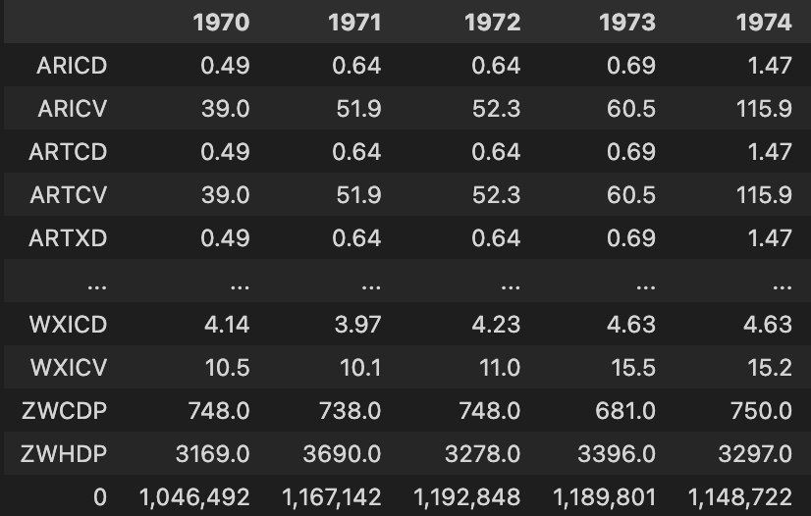
Sample:
Total Residential Energy Consumption Prediction:
Predict next year(or specified year) energy consumption based on other given prices.

Slide 9
04 Analysis
Notes:
Meeting 3

